Slide 1
OSI Model
OSI MODEL

Slide 2
Communication Architecture
OSI Model
Strategy for connecting host computers and other communicating equipment.
Defines necessary elements for data communication between devices.
A communication architecture, therefore, defines a standard for the communicating hosts.
A programmer formats data in a manner defined by the communication architecture and passes it on to the communication software.
Separating communication functions adds flexibility, for example, we do not need to modify the entire host software to include more communication devices.

Slide 3
Layer Architecture
OSI Model
Layer architecture simplifies the network design.
It is easy to debug network applications in a layered architecture network.
The network management is easier due to the layered architecture.
Network layers follow a set of rules, called protocol.
The protocol defines the format of the data being exchanged, and the control and timing for the handshake between layers.

Slide 4
Open Systems Interconnection (OSI) Model
OSI Model
International standard organization (ISO) established a committee in 1977 to develop an architecture for computer communication.
Open Systems Interconnection (OSI) reference model is the result of this effort.
In 1984, the Open Systems Interconnection (OSI) reference model was approved as an international standard for communications architecture.
Term “open” denotes the ability to connect any two systems which conform to the reference model and associated standards.

Slide 5
OSI Reference Model
OSI Model
The OSI model is now considered the primary Architectural model for inter-computer communications.
The OSI model describes how information or data makes its way from application programmes (such as spreadsheets) through a network medium (such as wire) to another application programme located on another network.
The OSI reference model divides the problem of moving information between computers over a network medium into SEVEN smaller and more manageable problems .
This separation into smaller more manageable functions is known as layering.

Slide 6
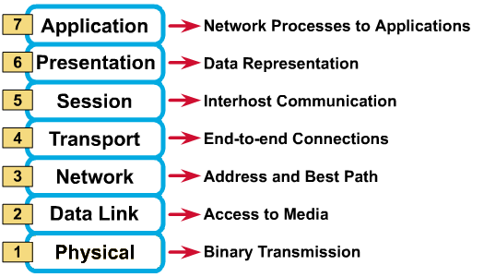
OSI Reference Model: 7 Layers
OSI Model

Slide 7
OSI: A Layered Network Model
OSI Model
The process of breaking up the functions or tasks of networking into layers reduces complexity.
Each layer provides a service to the layer above it in the protocol specification.
Each layer communicates with the same layer’s software or hardware on other computers.
The lower 4 layers (transport, network, data link and physical —Layers 4, 3, 2, and 1) are concerned with the flow of data from end to end through the network.
The upper four layers of the OSI model (application, presentation and session—Layers 7, 6 and 5) are orientated more toward services to the applications.
Data is Encapsulated with the necessary protocol information as it moves down the layers before network transit.

Slide 8
Application Layer
Application layer provides platform to send and receive data over the network. All applications and utilities that communicate with network fall in this layer. For examples
Browsers :- Mozilla Firefox, Internet Explorer, Google Chrome etc
Email clients: - Outlook Express, Mozilla Thunderbird etc.
FTP clients :- Filezilla, sFTP, vsFTP
Application layer protocols that we should know for exam are following:
SNMP (Simple Network Management Protocol) — Used to control the connected networking devices.
TFTP (Trivial File Transfer Protocol) — Used to transfer the files rapidly.
DNS (Domain Naming System) — Used to translate the name with IP address and vice versa.

Slide 9
Application Layer(cont..)
DHCP (Dynamic Host Configuration Protocol) — Used to assign IP address and DNS information automatically to hosts.
Telnet— used to connect remote devices.
HTTP (Hypertext Transfer Protocol) — Used to browse web pages.
FTP (File Transfer Protocol) — Used to reliably sends/retrieves files.
SMTP (Simple Mail Transfer Protocol) — Used to sends email.
POP3 (Post Office Protocol v.3) — Used to retrieves email.
NTP (Network Time Protocol) — Used to synchronizes clocks.

Slide 10
Presentation Layer
OSI Model
Presentation layer defines the format in which the data is to be exchanged between the two communicating entities.
Presentation layer prepares the data. It takes data from application layer and marks it with formatting code such as .doc, .jpg, .txt, .avi etc. These file extensions make it easy to realize that particular file is formatted with particular type of application. With formatting presentation layer also deals with compression and encapsulation. It compresses (on sending computer) and decompresses (on receiving computer) the data file. This layer can also encapsulate the data, but it’s uncommon as this can be done by lower layers more effectively.

Slide 11
Session Layer
OSI Model
Session layer provides mechanism for controlling the dialogue between the two end systems. It defines how to start, control and end conversations (called sessions) between applications.
This layer requests for a logical connection to be established on an end-user’s request.
Any necessary log-on or password validation is also handled by this layer.
Session layer is also responsible for terminating the connection.
This layer provides services like dialogue discipline which can be full duplex or half duplex.
Session layer can also provide check-pointing mechanism such that if a failure of some sort occurs between checkpoints, all data can be retransmitted from the last checkpoint.

Slide 12
Transport Layer
OSI Model
Purpose of this layer is to provide a reliable mechanism for the exchange of data between two processes in different computers.
Transport layer provides following services: -
It sets up and maintains the connection between two devices.
It multiplexes connections that allow multiple applications to simultaneously send and receive data.
According to requirement data transmission method can be connection oriented or connection less.
For unreliable data delivery connection less method is used.
Connection less method uses UDP protocol.
For reliable data delivery connection oriented method is used.
Connection oriented method uses TCP protocol.
When Implemented a reliable connection, sequence numbers and acknowledgments (ACKs) are used.
Reliable connection controls flow through the uses of windowing or acknowledgements.

Slide 13
Transport Layer(cont..)
Five main functions of transport layer:
Segmentation
Connection management
Reliable and unreliable data delivery
Flow control
Connection multiplexing

Slide 14
Transport Layer(cont..)
Segmentation
Segmentation is the process of breaking large data file into smaller files that can be accommodated by network. To understand this process thinks about a 700 MB movie that you want to download from internet. You have 2MBPS internet connection. How will you download a 700MB movie on 2MBPS internet connection?
In this case segmentation process is used. On server transport layer breaks 700MB movie in smaller size of segments (less than your internet connection speed). Assume that 700Mb movie is divided in 700 segments. Each segment has file size of 1Mb that your PC can easily download at current connection speed. Now your PC will download 700 small files instead of one large file. So next time when you see download progress bar in browser, think it about segment receiver progress bar. Once your browser receives all segments from server, it will pop up a message indicating download is completed. Transport layer at your PC will merge all segments back in a single 700Mb movie file. End user will never know how a 700Mb movie makes its way through the 2Mbps connection line.

Slide 15
Transport Layer(cont..)
Connection management
Transport layer setup, maintain and tear down connections for session layer. Actual mechanic of connection is controlled by transport layer. Transport layer use two protocols for connection management UDP and TCP.
UDP
UDP is a connection less protocol. Connection-less transmission is said to be unreliable. Now, don't get worried about the term "unreliable" this doesn't mean that the data isn't going to get its destination; its only means that it isn't guaranteed to get its destination. Think of your options when you are sending a postcard, put it in the mailbox, and chances are good that it will get where it's supposed to go but there is no guarantee. There is always a chance of missing in the way. On the other hand, it's cheap.
TCP
TCP is a connection oriented protocol. Connection-oriented transmission is said to be reliable. Think TCP as registry EMS facility available in Tanzania post office. For this level of service, you have to buy extra ticket and put a bunch of extra labels on it to track where it is going and where it has been. You get a receipt when it is delivered. In this method you have a guaranteed delivery. All of this costs you more—but it is reliable!

Slide 16
Transport Layer(cont..)
Reliability
Reliability means guaranteed data delivery. To insure delivery of each single segment, connection oriented method is used. In this approach before sending any segments three way handshake process is done.

Slide 17
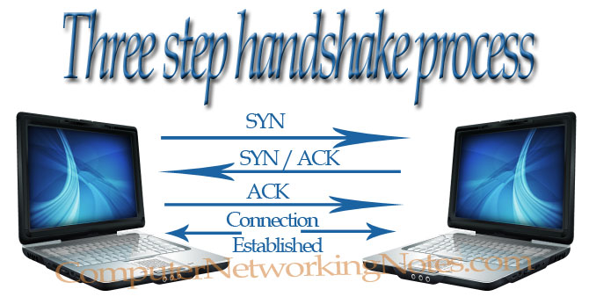
Transport Layer(cont..)
Three way handshake process
PC1 sends a SYN single to PC2 indicating that it wants to establish a reliable session.
P2 replies with ACK/SYN signal where ACK is the acknowledgment of PC1’s SYN signal and SYN indicates that PC2 is ready to establish a reliable session.
PC1 replies with ACK signal indicating that is has received SYN signal and session is now fully established.
Once connection is established data transmission will be initiated. To provide maximum reliability it includes following functions:-
Detect lost packets and resend them
Detect packets that arrived out of order and reorder them
Recognize duplicate packets and drop extra packets
Avoid congestion by implementing flow control

Slide 18
Transport Layer(cont..)
Connection Multiplexing/Application Mapping.
Connection multiplexing feature allows multiple applications to connect at a time. For example a server performs a number of functions like email, FTP, DNS, Web service, file service, data service etc. Suppose server has a single IP address, how will it perform all these different functions for all the hosts that want to connect with it? To make this possible transport layer assigns a unique set of numbers for each connection. These numbers are called port or socket numbers. These port numbers allow multiple applications to send and receive data simultaneously.

Slide 19
Transport Layer(cont..)
Common TCP and UDP Port Numbers
TCP |  | UDP
FTP | 20, 21 | DNS | 53
Telnet | 23 | DHCP | 67,68
SMTP | 25 | TFTP | 69
DNS | 53 | NTP | 123
HTTP | 80 | SNMP | 161
POP | 110
NNTP | 119
HTTPS | 443

Slide 20
Network Layer
OSI Model
Network layer is responsible for providing logical address known as IP address. Router works on this layer. Main functions of this layer are following:-
Define IP address
Find routes based on IP address to reach its destination
Defines the most optimum path the packet should take from the source to the destination
Defines logical addressing so that any endpoint can be identified.
Handles congestion in the network.
Facilitates interconnection between heterogeneous networks (Internetworking).
The network layer also defines how to fragment a packet into smaller packets to accommodate different media.

Slide 21
Data Link Layer
OSI Model
Data link layer attempts to provide reliable communication over the physical layer interface.
Breaks the outgoing data into frames and reassemble the received frames.
Create and detect frame boundaries.
Handle errors by implementing an acknowledgement and retransmission scheme.
Implement flow control.
Supports points-to-point as well as broadcast communication.
Supports simplex, half-duplex or full-duplex communication.

Slide 22
Physical Layer
Physical layer deals with communication media. This layer receive frame from data link layer and convert them in bits. It loads these bits on actual communication media. Depending on media type these bit values are converted in single. Some use audio tones, while others utilize state transitions—changes in voltage from high to low and low to high.

Slide 23
Data Exchange Process
In data exchange process, participating computers work in reverse mode. Layers on receiving computer perform the same task in reverse mode.
The receiving device takes delivery of, handles, and translates the data from the sending device at a particular layer. For example on sending computer presentation layer compress the data, same presentation layer on receiving computer decompress the data.

Slide 24
Data Exchange Process (cont.)
On sending computer
Sending application access the application layer.
Application provides data to the presentation layer.
Presentation layer format the data as per network requirement and forward it's to session layer.
Session layer initiate the connection and forward the data to the transport layer.
Transport layer broke down the large data file in smaller segments and add a header with control information, which are bits designated to describe how to determine whether the data is complete, uncorrupted, in the correct sequence, and so forth.
Segments are forwarded to the network layer. Network layer add its header, with logical address and convert it in packet. Network layer forwards packet to data link layer.
Data link layer attach its header and footer to the packet and convert it in frame.
Frames are forwarded to the physical layers that convert them in signals. These signals are loaded in media.

Slide 25
Data Exchange Process (cont.)
On receiving computer
Physical layer receive signals from media and convert them in frames. Frames are forwarded to the data link layer.
Data link layer check the frame. All tampered frame are dropped here. If frame is correct, data link layer strip down its header and footer from frame and hand over packet to network layer.
Network layer check the packet with its own implementations. If it's found everything fine with packet, it strips down its header from packet and hand over segment to transport layer.
Transport layer again do the same job. It verifies the segments with its own protocol rules. Only the verified segments are processed. Transport layer remove its header from verified segments and reassemble the segments in data. Data is handed over the session layer.
Session layer keep track of open connection and forwarded the receiving data to presentation layer.
Presentation form the data in such a way that application layer use it.
Application layer on receiving computer find the appropriate application from the computer and open data within particular application.

Slide 26
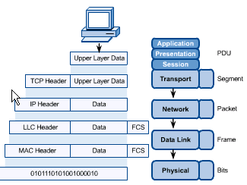
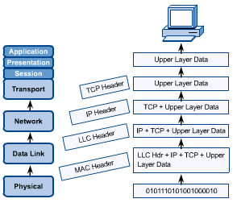
OSI in Action
OSI Model
A message begins at the top application layer and moves down the OSI layers to the bottom physical layer.
As the message descends, each successive OSI model layer adds a header to it.
A header is layer-specific information that basically explains what functions the layer carried out.
Conversely, at the receiving end, headers are striped from the message as it travels up the corresponding layers.

Slide 27
TCP/IP Model
TCP/IP MODEL

Slide 28
TCP/IP Model
TCP/IP Model
Application Layer
Application programs using the network
Transport Layer (TCP/UDP)
Management of end-to-end message transmission,
error detection and error correction
Network Layer (IP)
Handling of datagrams : routing and congestion
Data Link Layer
Management of cost effective and reliable data delivery,
access to physical networks
Physical Layer
Physical Media

